Slide 1
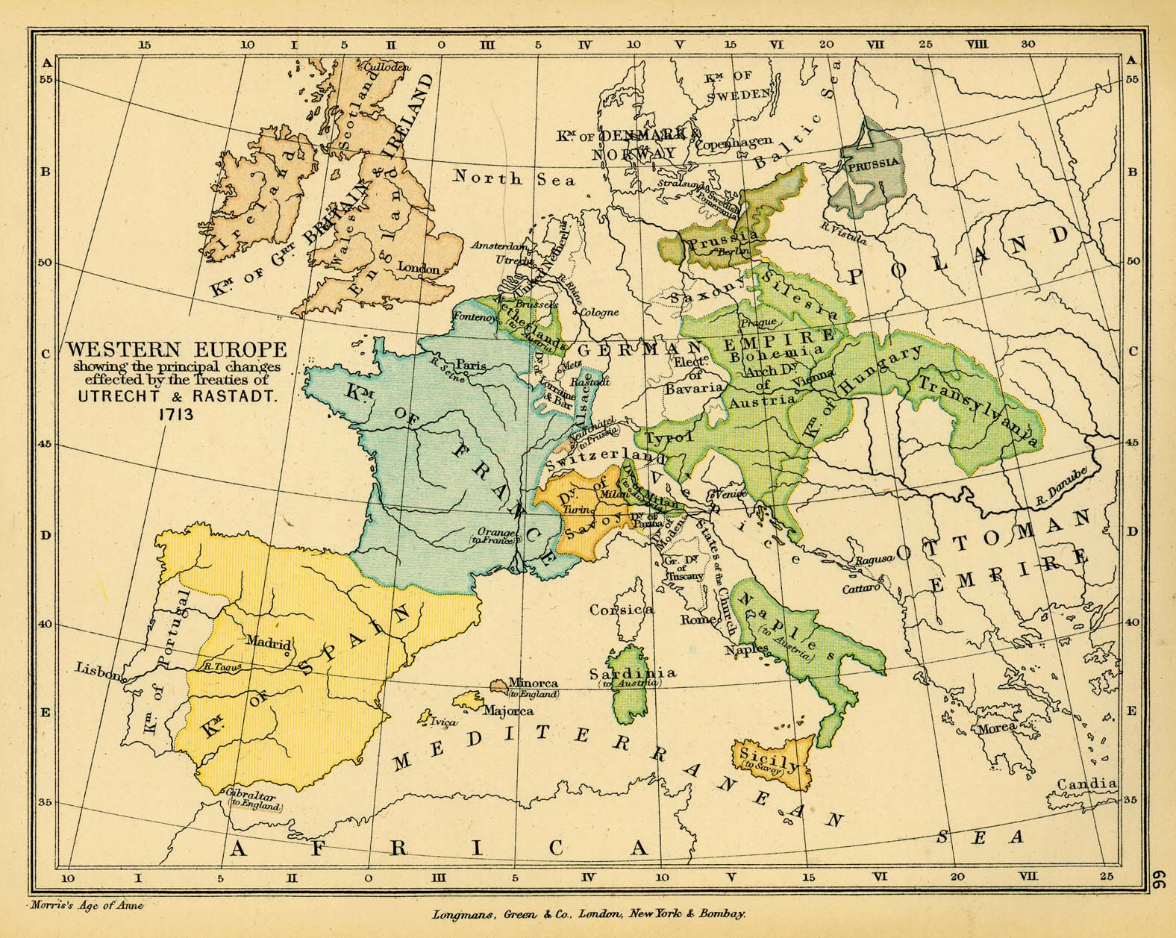
Enlightened Despotism
By: Will Schwartz
A.P. Euro

Slide 2
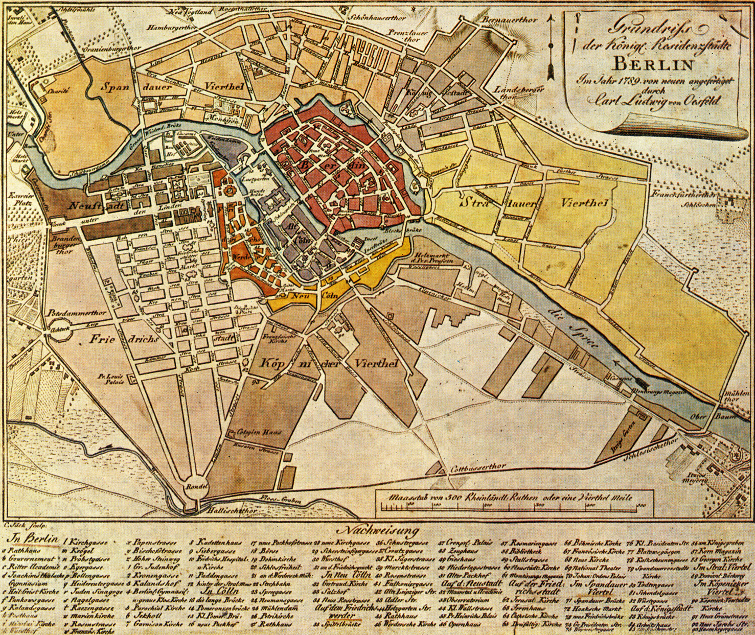
What is Enlightened Despotism?
Enlightened despotism (or enlightened absolutism) is when an absolute monarch is influence by the Enlightenment and uses its principles to govern their people.
Many were patrons of the arts and sciences, allowed freedom of speech and religion, created public primary education, and freed peasants from serfdom. Since they were influenced by the Enlightenment, many were influenced by the writers and philosophers of the time and their ideals, such as Voltaire and Montesquieu.

Slide 3

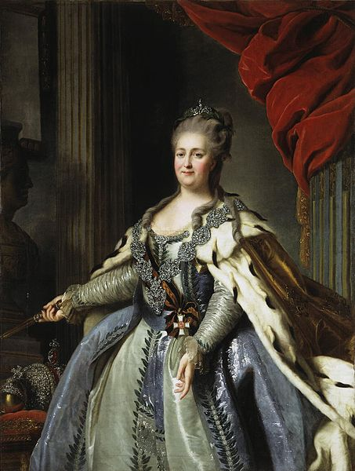
Catherine the Great of Russia
Her Rule and Reforms
Results
Catherine II Empress of Russia ascended the throne after a coup d'état that resulted in her husband, Emperor Peter III, being dethroned and killed.
She wanted Russia to follow the European route to a better economy, education system, and political stability.
Enlarged the Russian empire by expanding out into southern Ukraine, gaining large portions of the partitioned Polish-Lithuanian Commonwealth (Poland), and settling Alaska.
Under Catherine, the Russian economy and conscription didn’t veer from being based serfdom.
Reforms
  Gave the Russian aristocracy more rights and privileges while making them exempt from having to hold government or military positions.
  She established a two-tier education system in all major cities that was free to every free citizen (no serfs).
    Russian Statute of National Education
    Smolny Institute for Noble Maidens
  Freed serfs from the rule of the Russian Orthodox Church.
Under her enlightened rule and encouragement the Russian Enlightenment took root.
Since Catherine extended the rights of the nobility and refused to ease the loads that the serfs bared, such as taxes, they revolted. The most famous of these revolts was the Pugachev’s Rebellion.
The aristocracy gained more influence over the Empress and after her death had much more control over political affairs in Russia.

Slide 4
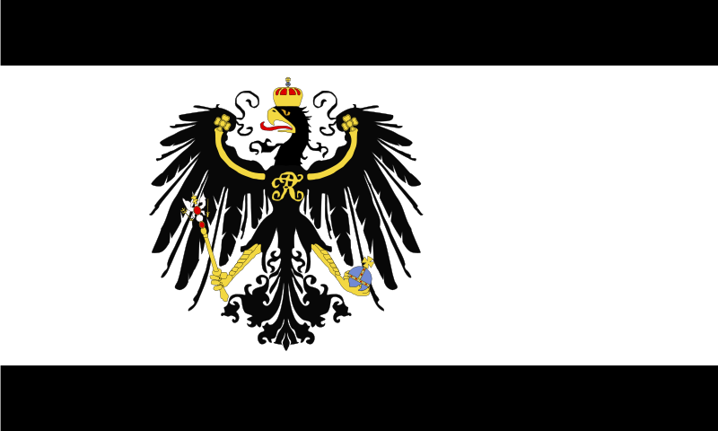
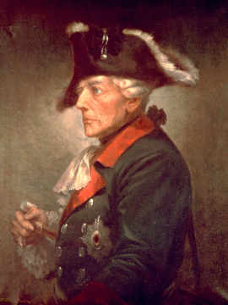
Frederick the Great of Prussia
Rule and Reforms
Results
He created an even more powerful military state than his father Frederick William I Elector of Prussia had. He expanded conscription, creating the largest Prussian army ever, and used unified tactics and training to make the Prussia a European power.
Took power away from the German princes and centralized power under the king.
Reforms
  Reformed the educational system in Prussia, allowing all to have state-funded primary schooling.
      General-Landschulreglement (General Education Regulations)
  Encouraged emigration into Prussia to boost the population and army reserve. About 300,00 in total.
  Created Berlin and made it capital of the Prussia.
  Banned capital punishment and torture, while unifying the law under the General National Law for the Prussian States (Allaemeines Landrecht für die Preusseschen Staaten).
  Financed the mending and creating of infrastructure.
  Allowed freedom of the press and religion.
  Abolished serfdom.
Prussia became a major European superpower due to Frederick’s wide-spread reforms.
The Prussian army became the most coordinated and most powerful in all of Europe.
His reforms bettered the lives of his subjects, though only slightly.
Religious toleration and encouraged emigration substantially increased the Prussian population, creating a more diverse Prussian culture.

Slide 5

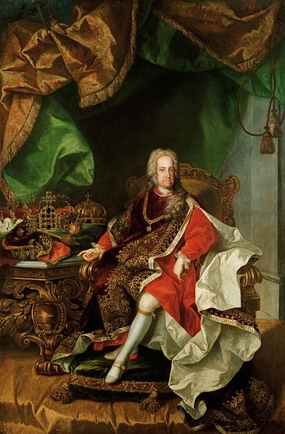
Charles III of Spain
His Life and Rule
Results
Became Duke of Parma as an infant. When he had grown he conquered Naples ands Sicily, reigning as Charles VII of Naples and Charles V of Sicily.
Created a insurance company and made widespread economic reforms to save the kingdom of Sicily from financial ruin.
  Many of the numerous reforms he made in Naples and Sicily transcended into his rule in Spain. He consolidated power under the crown and rearranged the Spanish bureaucracy.
  As in Italy, he made large economic reforms such as eliminating the traditional tax on flour.
  Tried to structure his government so that trade and industry would flourish. Lynch
  Abolished money-wasting ventures and promoted the building of roads, canals, and economic societies (Earlier versions of Chambers of Commerce).
  Promoted trading with foreign sources of commerce such as the United States and many other American colonies.
Under his rule and jurisdiction, the kingdoms of Spain were recognized as an nation, not separate states.
His control over the Catholic Church and election of inquisitors limited the power of the Inquisition.
His alterations to the government created a more industrialized Spain.
Spain had more access to foreign trade and commerce, but still excluded foreigners.
Spain became more economically successful, but not nearly as much as Naples had under Charles’ rule.
The Spanish people had a greater sense of patriotism.

Slide 6

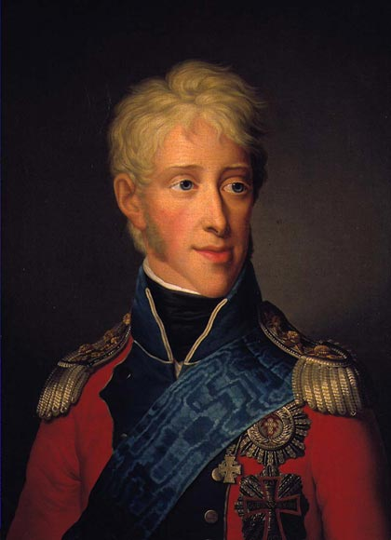
Frederick VI of Denmark
His Life and Rule
Results
Took control of the regency from his step- grandmother, the Queen Dowager Juliana Maria of Brunswick-Wolfenbüttel, and her son Prince Frederick in a bloodless coup.
Made most, if not all, of his political reforms while regent under his father Christian VII of Denmark.
  While ruling as regent, he made several political, economic and social reforms in Denmark. Abolished serfdom in all Danish holdings in 1788
  Widespread economic reforms (not extremely productive).
Tried to stay neutral during the French Revolution and the Age of Napoleon, but then sided with the emperor after attacks by the British at The Battle of Copenhagen in 1801 and 1807.
After the Napoleonic Era, economic depression hit Denmark due to faulty leadership.
Reenacted censorship and suppressed all opposition
Created the Assemblies of the Estate , although it was purely used for advisement. The Assemblies had no executive power.
Some of his reforms as regent didn’t last longer than his reign.
His support of Napoleon cost Denmark the Netherlands and Heligoland at the Congress of Vienna.

Slide 7

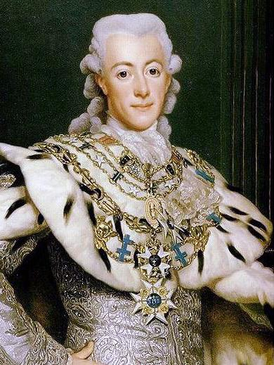
Gustav III of Sweden
His Rule and Reforms
Results
Brought about an end to the corrupted rule of the Riksdag. The Riksdag was mainly run by the Swedish nobility in the Secret Committee, a group that dealt with finances and foreign affairs. Regained the government under the control of the monarchy in a coup d’etat.
Created a new constitution for Sweden, giving the rulers much more government control than they had previously.
Reformed and stabilized the Swedish economy with help from Johan Liljencrantz, Swedish Secretary of State for Trade and Finance. ( Currency Realization Ordinance of 1776)
Gave more tolerations to Jews and Catiolics.
Was a patron of the arts, opening the Royal Opera House in 1782 and a Swedish Academy in 1786. Created the Swedish National Costume.
Strengthened the navy and army. Used this new navy to gain territory for the already numerous Swedish holdings.
    Saint Barthélemy (Caribbean Island)
Was invoved in a number of wars, both in with the Russians on the Finish-Russian border, but also with the Danish. Interfered in the early French Revolution.
He reused to comply with many of the nobility in Sweden, often going behind their backs. This led to a dislike of the King in most of the aristocracy.
The people loved him for the reformes he made in their favor.
Towards the end of his reign he sent Sweden into near bankruptcy due to debts brought on by his war with the French.
One of the most celebrated Swedish monarchs in history.

Slide 8
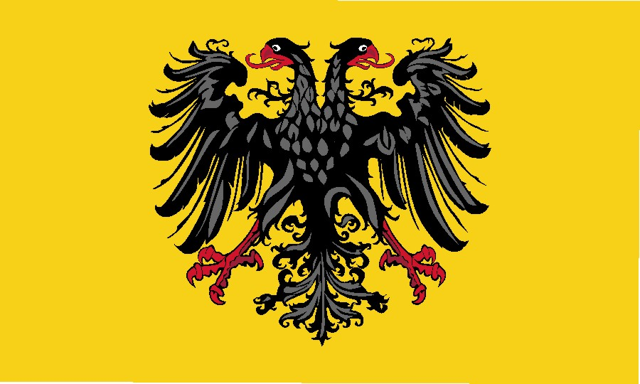
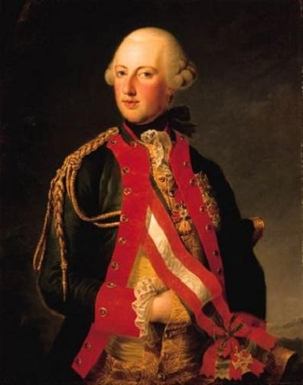
Joseph II of the Holy Roman Empire
Reforms
Results
Continued the religious, economic, and judicial reforms started by his mother, Empress Maria Theresa.
Reforms were based on ideology and the Jacobin formatting of laws. [Utilitarianism]
Wanted to free people from feudal burdens, promote freedom of religion and speech, weaken Catholic Church
Made major reforms after the end of the co-regency with his mother Maria Theresa. Freed peasants from burdens of feudalism n
    Holy Orders 1781
  Greater religious toleration (Edict of Toleration, 1781) LOC
  Consolidated the education system under the government, expanded it throughout Austria. (not Hungary) Britannica
  Dissolved many religious institutions and outlawed some customs
  Attempted to codify the government
    Codex Theresianus
    Josephinian Code
Countless Revolts soon ensued due to sudden change
Unified crime proceedings and education under certain guidelines.
Some government officials refused to enact his orders due the results of his other reforms.
January 30th, 1790: Joseph II formally withdrew every one of his reforms due to severe public dislike and rioting.

Slide 9
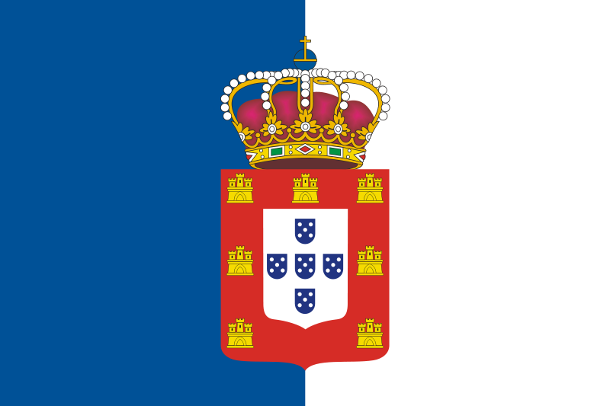
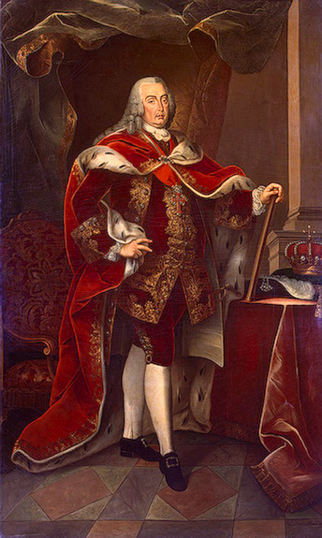
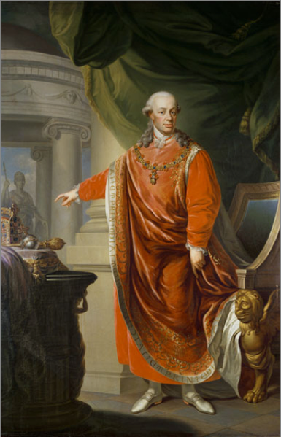
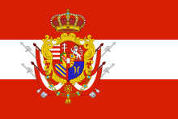
Smaller Enlightened Monarchs
Joseph I of Portugal
Leopold I Grand Duke of Tuscany
Enacted all of his reform with great advisement of Sebastião José de Carvalho e Melo, the Marquis of Pombal
  Expelled the Távora family and the Jesuits from Portugal, and depleted some of the power held by the High Aristocracy of Portuagl
  Edited many of the laws pertaining to the governing of the colonies, the economy, and court life.
  He abolished torture, capital punishment, and capital executions.
  Lead Tuscany into an age of economic prosperity.
  Treated those deemed mentally insane with compassion as opposed to prison and set the up in hospitals to be treated. (Law on the Insane).
  Almost set up a constitution but left to rule the Holy Roman Empire before it could be put into affect.
As Holy Roman Emperor, Leopold II (Holy Roman Emperor) didn’t use the enlightenment ideals to govern his lands.

Slide 10
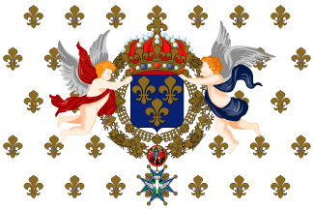
Enlightened Absolutism in France
Louis XVI of France
Napoleon I Emperor of France
While still an absolutist king, Louis attempted to use enlightenment ideals to rule France. The aristocracy acted with hostility towards this, so much of his planned reforms were never put into action.
  Tried to totally abolish serfdom and the taille, a direct land tax all French citizens of non-noble birth.
  The Edict of Toleration (The Edict of Versailles)- a law nullifying the Edict of Fontainebleau which gave many Protestant sects and Jews the rights possessed by all French Catholic citizens.
  Reinstated the parlements in France.
  Attempted to please the public through his legislation, using advisors of the people.
Instituted a constitutional monarchy with the newly created National Assembly. His reforms stop at this point.
While First Consulate for Life and Emperor of France, Napoleon Bonaparte mad long-lasting reforms throughout his reign.
Reforms:
  His main reform was The Napoleonic Code or the Civil Code. This instituted many of the ‘human rights’ that the previous French monarchy had ignored: All people have a fair trail under the law. None are exempt from any laws. Everyone is equal under the law. Etc.
  He reformed the education system to a two-level system. The first level, primary school, was free to all males in France while the second level, the university system, was also free to all males but required tuition. This replaced the previously used lycée.
  Allowed freedom of religion.
  He introduced the metric system of measurement into France.

Slide 11

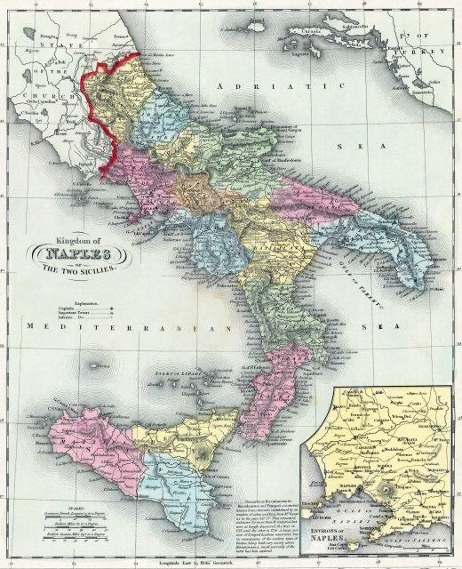
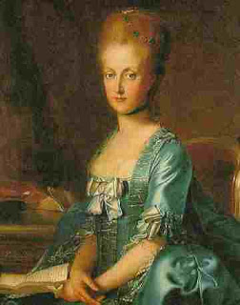
Maria Carolina of Austria, Queen of Naples
Her Reign and Reforms
Results
As Queen Consort, she ascended to control the Neapolitan government through the Marquis of Sambuca after the dismissal the advisor Tanucci.
Through the Liberalist thinker John Acton, Mariz Carolina made many of her enlightened reforms.
Rebuilt the Neapolitan army and navy to strengthen it. She also created four marine colleges to instruct the naval officers in the revamped Neapolitan navy.
Opened themselves to trade with more of Europe, even as far north as the Russian Empire.
Some economic reforms were taken, mainly the cutting of expenditure in government departments.
After the decapitation of her sister Marie Antoinette, Maria Carolina formed Naples into a twelve-district police state so that France’s revolutionary influence wouldn’t cause rebellion in the kingdom.
Her revisions to the armed forces set the kingdom up for armed attacks and defense such as Naples's participation in the First Coalition in France.
Maria Carolina’s insistent urge to fight the French led to her husband and herself fleeing from Napoleon’s army and the loss of their kingdom. This loss created the Parthenopean Republic.

Slide 12
Joseph I of Portugal
The Industrial Revolution
The Victorian Era
17th Century – 18th Century
The Enlightenment
The French Revolution
Louis XVI of France
Carlos III of Spain
Napoleon Bonaparte, Emperor of France
Frederick the Great of Prussia
Frederick VI of Denmark
1710 A.D.
1720 A.D.
1730 A.D.
1740 A.D.
1750 A.D.
1760 A.D.
1770 A.D.
1780 A.D.
1790 A.D.
1800 A.D.
1810 A.D.
1820 A.D.
1830 A.D.
1840 A.D.
1850 A.D.
1860 A.D.
1870 A.D.
1880 A.D.
1890 A.D.
1900 A.D.
Catherine The Great of Russia
Maria Carolina of Austria,
Queen of Naples
Joseph II of the Holy Roman Empire
The Seven Years War
Leopold I, Grand Duke of Tuscany

Slide 13
Comparing the Deeds of the Enlightened Despots
Enlightened Despots | Public Education | Freedom from Serfdom | Revisons to Taxes | Strengthen the Military | Restructured the Government Bureaucracy | Freedom of Religion | Helped the Economy
Catherine the Great of Russia | yes | no | yes | no | yes | no | yes
Carlos III of Spain | no | no | yes | no | no | no | yes
Frederick the Great of Prussia | yes | yes | yes | yes | yes | yes | yes
Frederick VI of Denmark | no | no | yes | no | yes | no | no
Gustav III of Sweden | no | no | yes | yes | yes | yes | yes
Joseph II: Holy Roman Emperor | yes | yes | yes | no | no | yes | yes
Joseph I of Portugal | no | no | yes | no | yes | no | yes
Leopold I: Grand Duke of Tuscany | no | no | yes | no | no | yes | yes
Louis XVI of France | yes | yes | yes | no | no | yes | yes
Napoleon I: Emperor of France | yes | no | yes | yes | yes | yes | yes
Maria Carolina of Austria; Queen of Naples | no | no | yes | yes | no | no | yes

Slide 14
Works Cited
“Austria-Penal Codes.” Mongabay.com. Mongobay, 2010. Web. 15 Dec. 2012.
“Catherine the Great (Catherine II).” Saint-Petersburg.com. Saint-Petersburg. Com, 2001. Web. 17 Dec. 2012.
“Charles III.” ENCYCLOPÆDIA BRITANNICA. Encyclopædia Britannica Inc, 2012. Web. 14 Dec. 2012.
Danish in the North and the South. Copenhagen: Royal Danish Ministry of Foreign Affairs, 1989. Print.
“Enlightened Absolutism.” Buzzl.com. Buzlecom, 2011. Web. 14 Dec. 2012.
“Frederick II (Frederick the Great, German: Friedrich der Große).” Science, Civilization, and Society. Matthias Tomczaks, n. d. Web. 15 Dec. 2012.
“Frederick II (The Great).” WebChiron. David W. Koeller, 1999. Web. 15 Dec. 2012
“Frederick VI.” Infoplease.com. The Columbian Electronic Encyclopedia, 2011. Web. 16 Dec. 2012.
“Frederick VI of Denmark.” Spokeo. Spokeo People Search, 2012. Web. 16 Dec. 2012.
“Gustav III of Sweden: The Forgotten Despot of the Age of Enlightenment.” HistoryToday. History Today Magazine Co. 2012. Web. 16 Dec. 2012.
Haslip, Joan. Catherine the Great A Biography. New Garden: Joan Haslip, 1977. Print.
“Joseph II.” ENCYCLOPÆDIA BRITANNICA. Encyclopædia Britannica Inc, 2012. Web. 14 Dec. 2012.
“Joseph, II.” Gale Biography. Glenbrook South High School, 1994. Web. 14 Dec. 2012.
“Joseph II.” NNDB: Tracking the World. Soyloent Communications, 2012. Web. 14 Dec. 2012.
Kann, Robert A. A History of the Habsburg Empire. Berkley: University of California Press, 1972. Print.
“Leopold II, Holy Roman Emperor, King of Bohemia and Hungary.” Yahoo !Education. Yahoo! Inc, 2009. Web. 17 Dec. 2012.
MacDonogh, Giles. Frederick the Great. New York: St. Martin’s Press, 1999. Print.
“Maria Carolina of Austria, Queen of Naples.” The Habsburg Monarchist. Awesome Inc, n. d. Web. 18 Dec. 2012.
Moberg, Vilhelm. A History of the Swedish People. New York: Dorset Press, 1989. Print.

Slide 15
The Effects of Enlightened Absolutism in Europe
This era of Enlightenment ideals increased the power of the rulers. As a result most of the institutions under them that they had taken power from lost a significant amount of influence in the government. Examples are the Catholic Church, the aristocracy (except in Russia), and the representative bodies such as Riksdag.
The subjects under these enlightened despots benefited too because their rights, freedoms, and protections increased exponentially compared to what they rights they possessed before.

